Slide 1
ALPHA COLLEGE OF ENGINEERING
Guide By: Ravi Patel

Slide 2
ELECTRICEL-B
Subject-E.M.E.
Batch-1
Group-4
Group Members:
1.Tomar Abhishek
2.Patil Jigar
3.Mehta Dhruv
4.Jayswal Hardeep
5.Prajapati yash
6.Patel Daivik

Slide 3
Understanding Principles of Operation of Internal Combustion Engines

Slide 4
Interest Approach
Identify the different types of internal combustion engines used to power the machines.

Slide 5
Learning Objectives
Define internal combustion engine and explain its principal parts.
Describe the four events of the internal combustion engine.
Explain the differences in operation of four-stroke and two-stroke internal combustion engines.
Classify internal combustion engines.

Slide 6
Terms
Compression
Compression stroke
Connecting rod
Crankshaft
Cycle
Cylinder
Diesel engines
Engine block
Engine displacement
Exhaust
Exhaust stroke
Flat
Four-stroke engine
Gasoline Engines
In-line

Slide 7
Terms (continued)
Intake
Intake stroke
Internal combustion engine
Large engines
Multi-cylinder
Piston
Power
Power stroke
Reed valves
Single-cylinder
Small Engines
Two-stroke engine
Vee-block
Wrist pin

Slide 8
Internal Combustion Engines
A internal combustion engine is a device that converts the energy contained in fuel into rotating power
Various parts are housed within an engine block

Slide 9
4 parts of the engine block
1) Cylinder – the part of the engine block where the combustion takes place.
Varies from 1 to 8
2) Piston – a plunger with rings that fit against the inside cylinder walls and prevent air from leaking past

Slide 10
4 parts of the engine block
3) Connecting rod – connects the piston to the crankshaft.
Fastened by the wrist pin
4) Crankshaft – shaft with offsets to which the connecting rods are attached

Slide 11
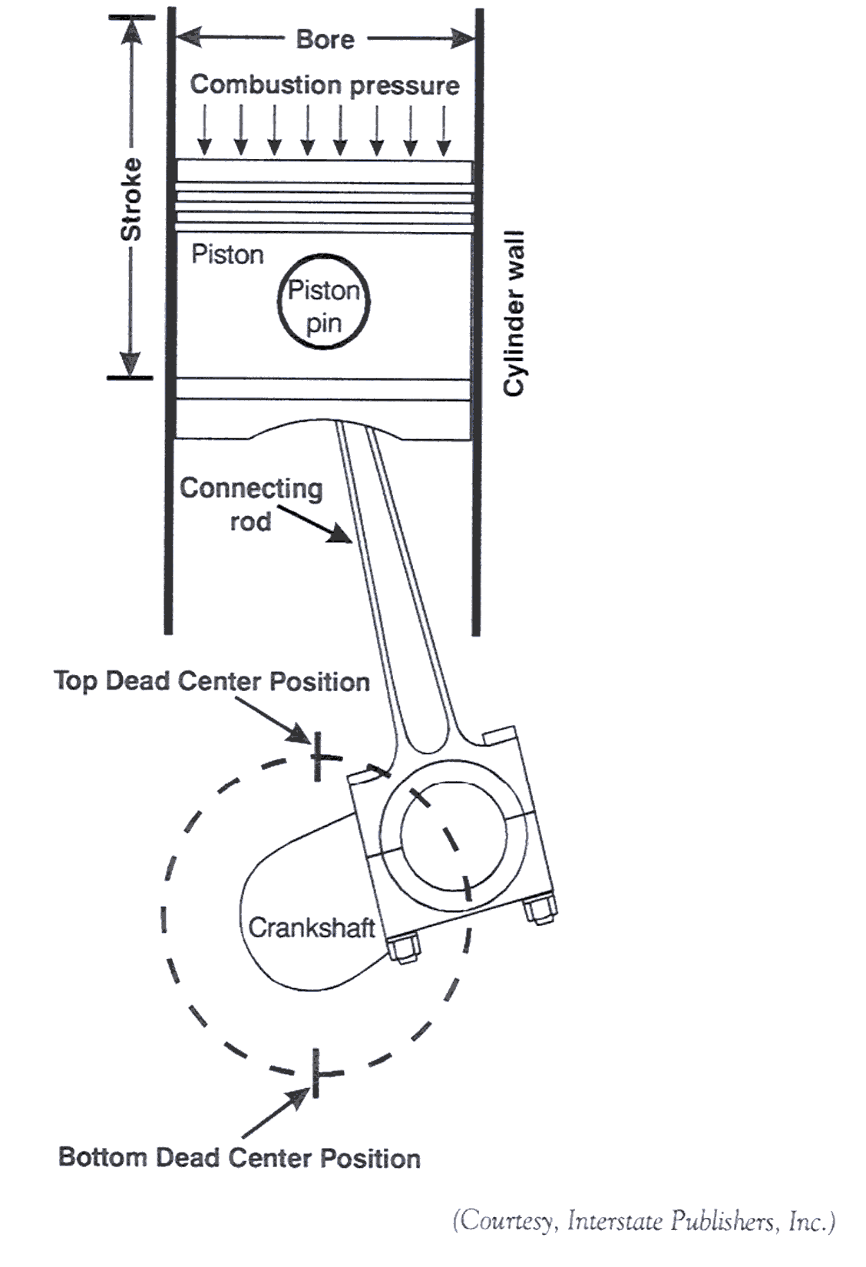
Bore and stroke of a cylinder

Slide 12
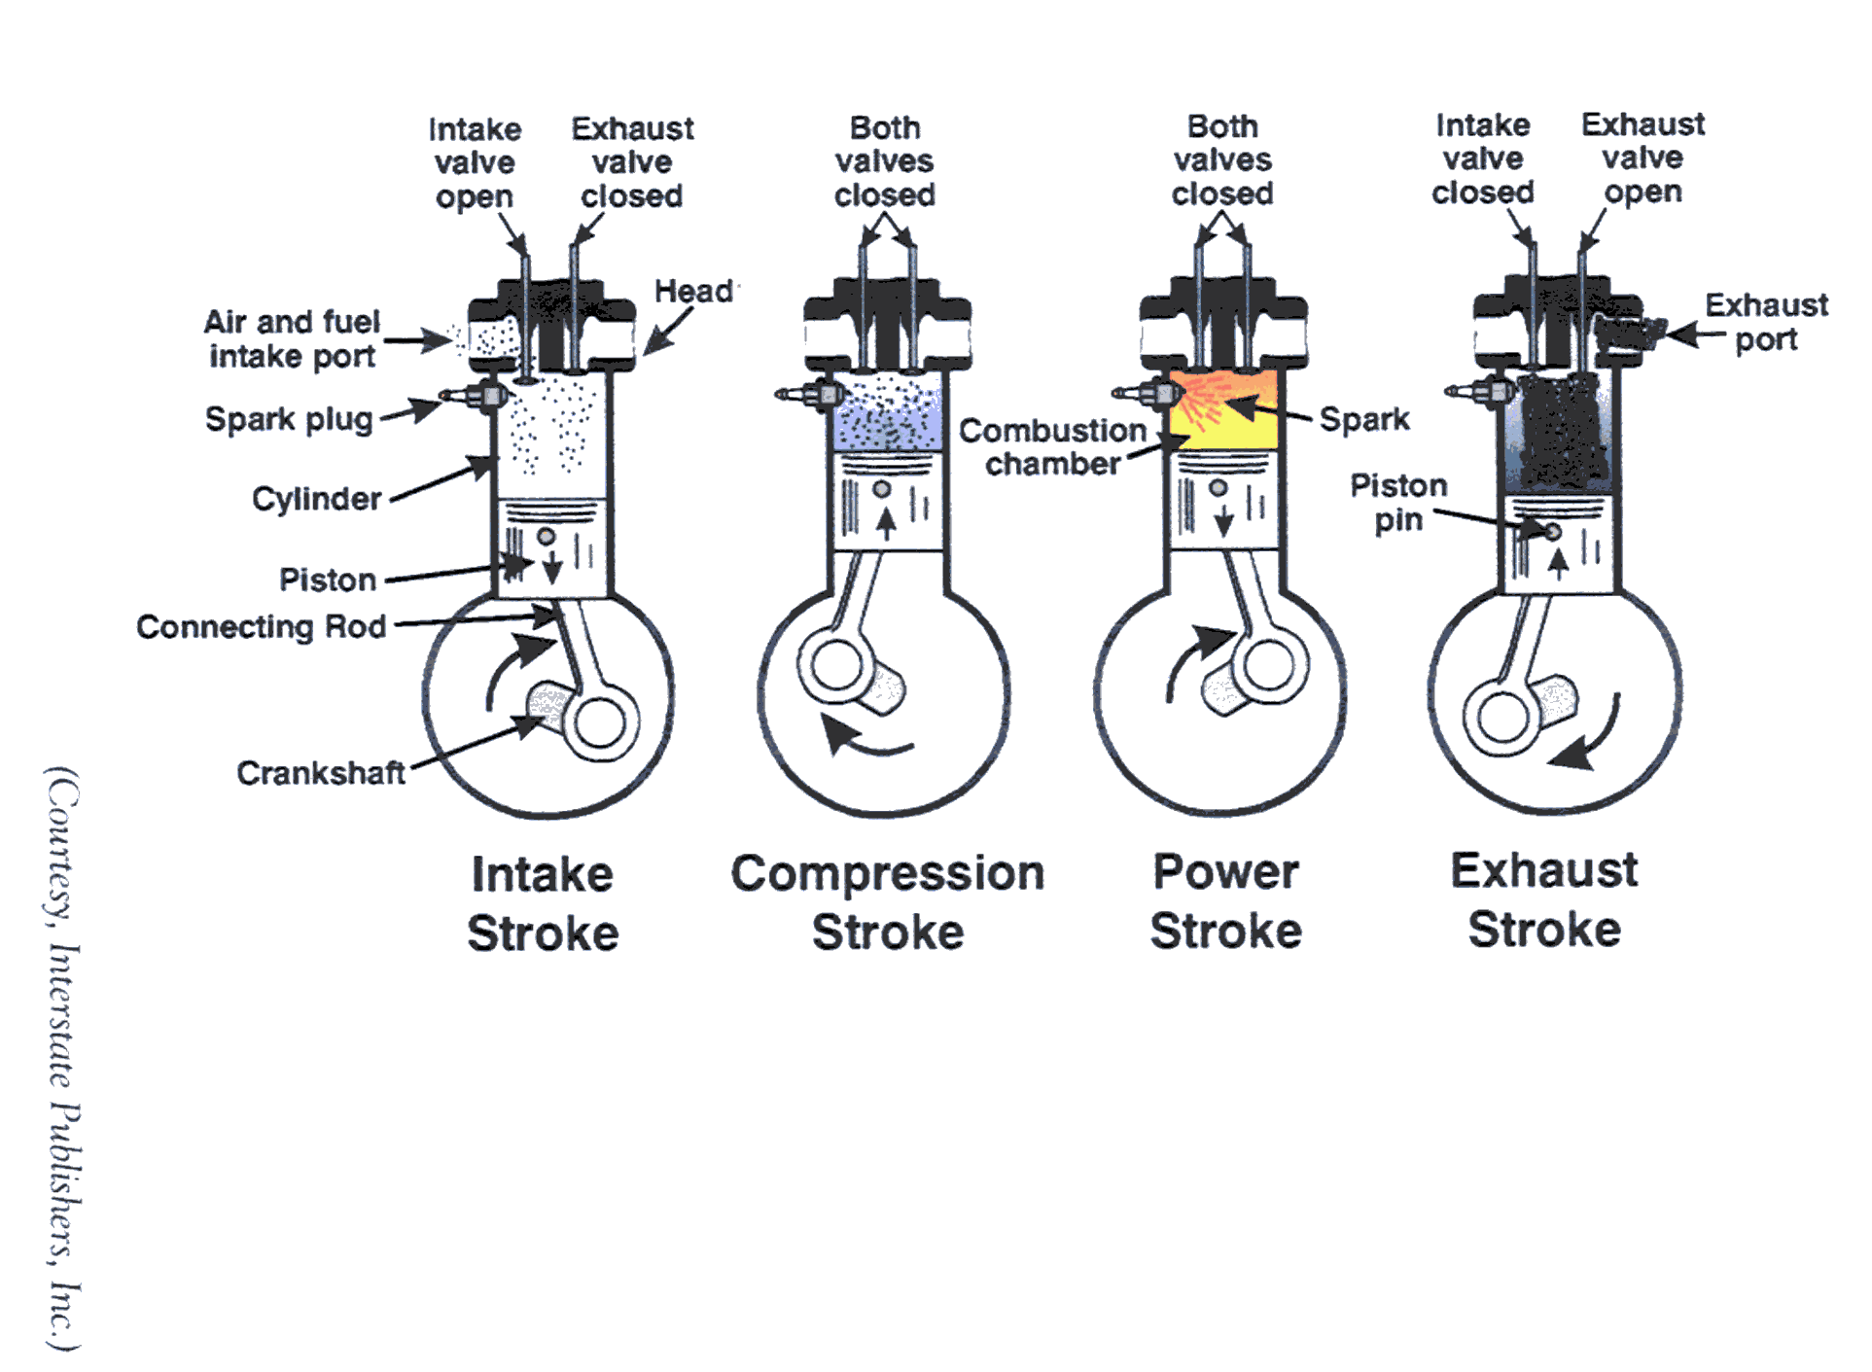
Four-stroke cycle engine

Slide 13
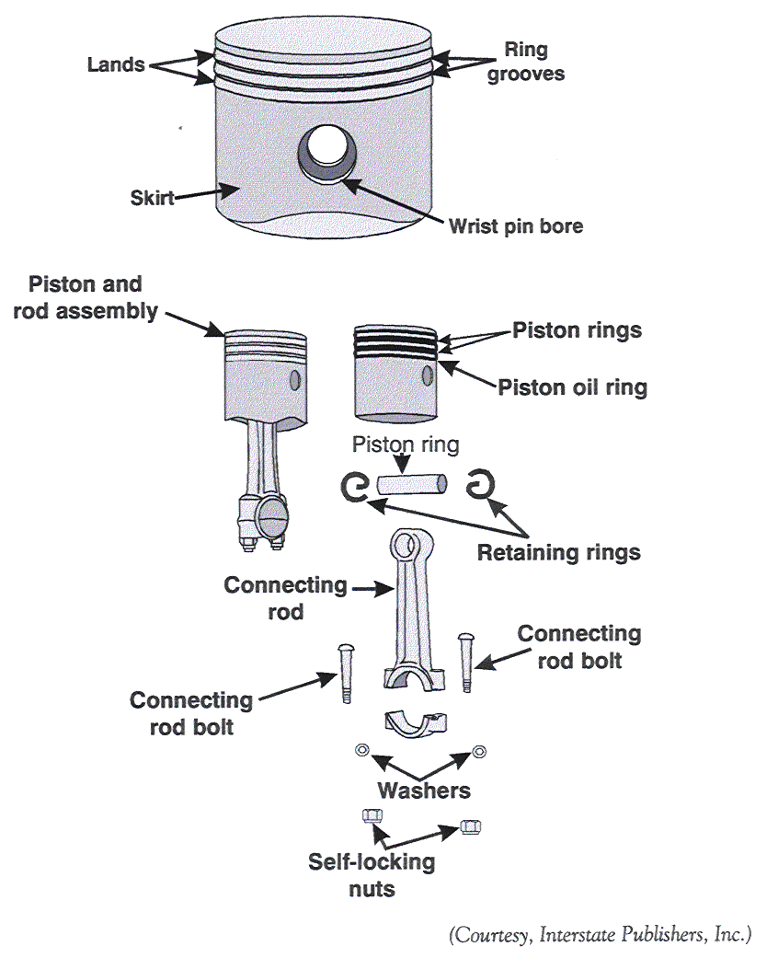
Piston and connecting rod

Slide 14
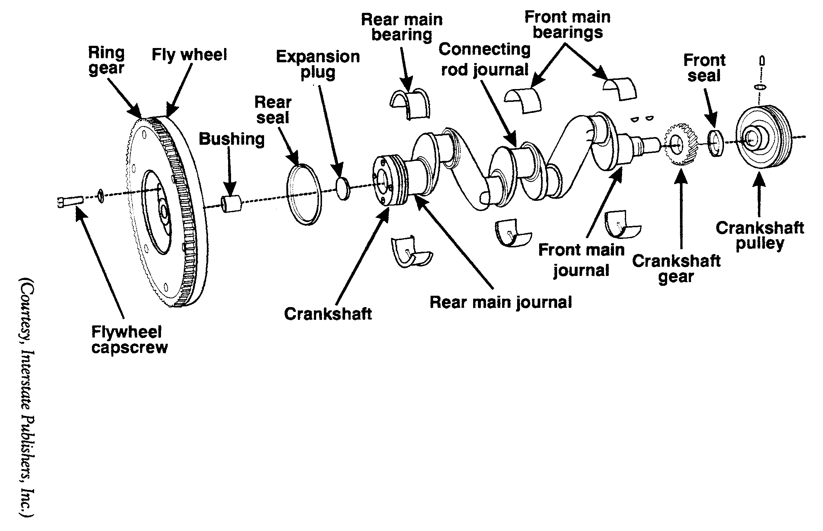
Crankshaft assembly

Slide 16
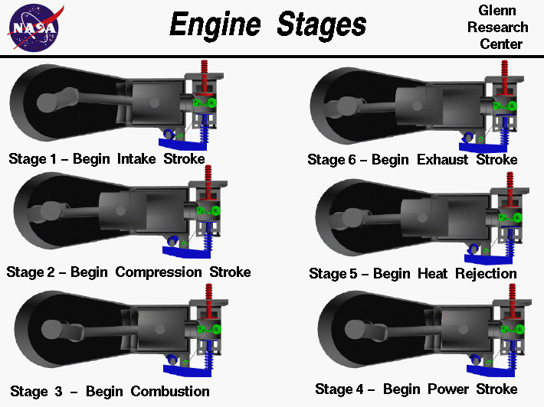

Slide 17
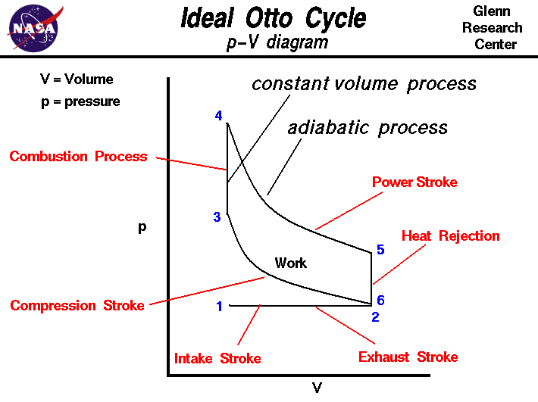

Slide 18
Internal Combustion Engine - Events
The internal combustion engine operates based upon the principle of a cycle
A cycle is a series of events that are repeated over and over again
Four strokes make up a cycle: intake, compression, power, exhaust

Slide 19
Differences between four- and two-stroke engines
A four-stroke engine has a series of four events that must be completed within the cycle.
A two-stroke engine completes the same series of four events in two strokes.

Slide 20
Four stroke cycle : It has four piston strokes over two revolutions for each cycle.
Two stroke cycle : It has two piston strokes over one revolution for each cycle.
We will be dealing with Spark Ignition engine and Compression Ignition engine operating on a four stroke cycle.

Slide 21
Intake
The process of getting the fuel and air required for combustion to take place in the chamber.
Exhaust valve remains closed and intake valve is open

Slide 22
Compression
The process of compressing the fuel-air mixture in the combustion chamber to increase the potential chemical energy of the heat from combustion.
Intake and exhaust valves are closed.

Slide 23
Power
The result of converting the chemical potential energy to mechanical power by the rapid expansion of heated gasses.
Gases produced by the combustion of the compressed fuel-air mixture in the combustion chamber.

Slide 24
Exhaust
The process of removing the spent products resulting from combustion in the combustion chamber.
Exhaust valves opens and spent gasses are forced from the cylinder.

Slide 25
Crankshaft : Rotating shaft through which engine work output is supplied to external systems.
The crankshaft is connected to the engine block with the main bearings.
It is rotated by the reciprocating pistons through the connecting rods connected to the crankshaft, offset from the axis of rotation. This offset is sometimes called crank throw or crank radius.
Connecting rod : Rod connecting the piston with the rotating crankshaft, usually made of steel or alloy forging in most engines but may be aluminum in some small engines.
Piston rings: Metal rings that fit into circumferential grooves around the piston and form a sliding surface against the cylinder walls.

Slide 26
Four-stroke engine
4 events completed in each stroke:
Intake
Compression
Power
Exhaust

Slide 27
Two-stroke engine
Completes the same four events in two strokes.
1st stroke – release of exhaust gasses drives the piston downward.

Slide 28
Two-stroke engine
2nd stroke – release of exhaust gasses drives the piston downward.
Reed valves – one-way directional valves that allow the air-fuel mixture to enter the crankcase.

Slide 29
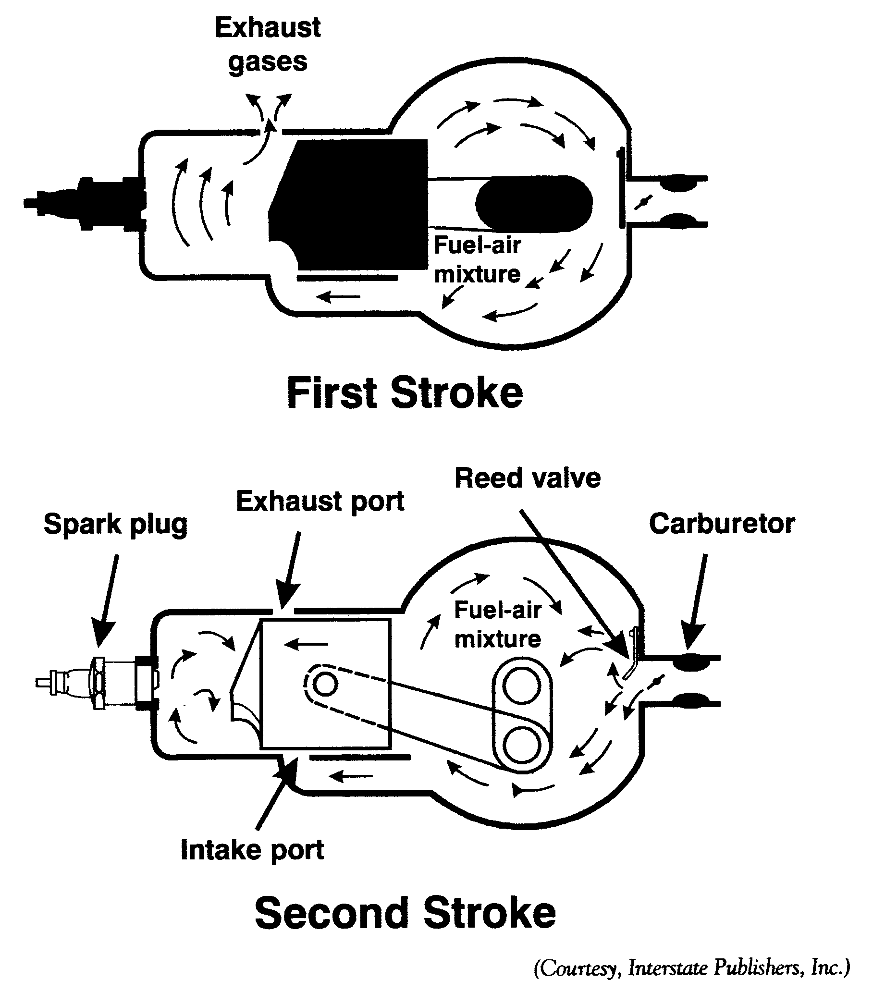
Two-stroke engine

Slide 30
Classifying Internal Combustion Engines
There are many ways by which internal combustion engines are classified
Piston strokes
Engine power
Number of cylinders
Engine displacement
Cylinder arrangement
Fuel ignition

Slide 31
Piston strokes
Two-stroke
Four-stroke

Slide 32
Engine power
Small engines – produce less than 25 horsepower.
Large engines – produce more than 25 horse power.

Slide 33
Number of cylinders
Single-cylinder – engines have only one cylinder.
Multi-cylinder – engines have 2, 3, 4, 5, 6, 8, or more cylinders.

Slide 34
Engine Displacement
Describes the total swept volume of the engine cylinders as pistons complete one stroke.
Expressed as either cubic inches or cubic centimeters.

Slide 35
Cylinder arrangement
In-line – all of the cylinders are in a straight line.
Vee-block – cylinders arranged in a “V” configuration.
Flat – cylinder arrangements are perpendicular, or flat, in the relation to the earth.

Slide 36
Fuel ignition
Gasoline engines – fuel-powered by a spark ignition.
Diesel engines – use glow plugs and fuel in compression ignition.

Slide 37
Characteristics of two- and four-stroke engines
Two-stroke Cycle Engines | Four-Stroke Cycle Engines
Lighter weight Operates in many positions Higher power to weight ratio Engine oil usually mixed with fuel Louder operation Higher Engine speeds More vibration Rough idling operation | Heavier weight Operates in limited positions Lower power to weight ratio Engine oil in a reservoir Quieter operation Slower engine speeds Smoother operation Smoother idling operation

